Slide 1



CREDIT DYNAMICS ANALYSIS
Presentation - 2023
Explore the intricate relationship between household income and credit card debt to optimize financial strategies and achieve fiscal goals.
nardossolomon.com

Slide 2

Financial Wisdom
Understanding the impact of credit card debt is crucial for financial well-being. Minimizing debt ensures a top-tier credit score, unlocking cost savings on major expenses like mortgages and car loans.
Notably, households with higher incomes often bear larger credit card debts. For example, those in the 90th to 100th income percentile carry an average debt of $12,600—over three times the debt of the lowest income bracket (less than the 20th percentile) with an average of $3,800 (Source: Doug Milnes, CFA, 2022 "Average Credit Card Debt in America"). Explore the nuances of credit dynamics for informed financial decision-making.

Slide 3
Hypotheses
No relationship between credit card debt and household income
H0
A relationship exists between credit card debt and household income
H1

Slide 4
Credit card company’s customer data with 4967 observations and 10 variables
Dependent Variable: Credit Card Debt
Independent Variables: Customer ID, Gender, Age, Education Years, Union Member, Employment Length, HHIncome, Debt To Income Ratio, Other Debt

Slide 5
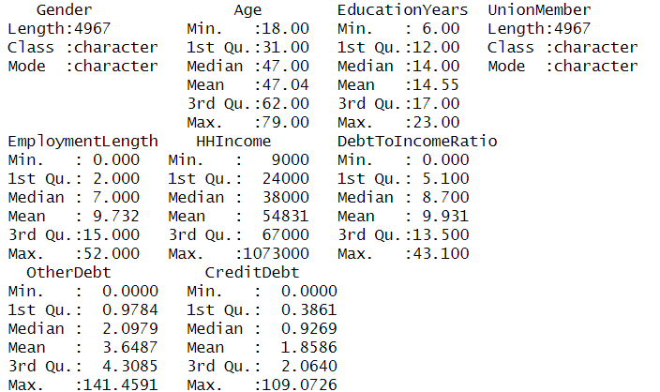
DATA SUMMARY

Slide 6
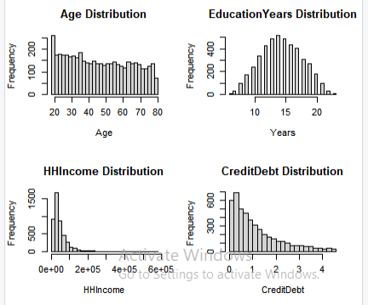
Data Distribution
skewed distributions in household income and credit card debt underscore the heterogeneity in financial profiles within the dataset.

Slide 7
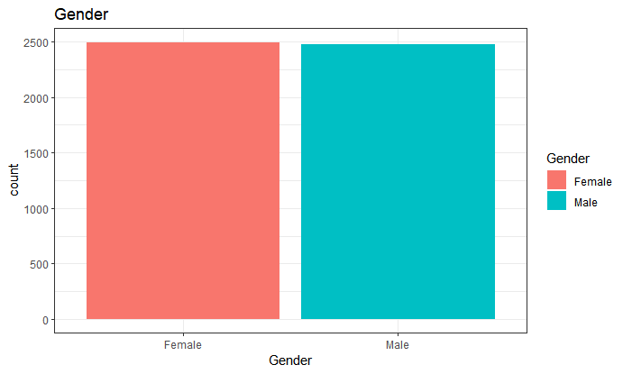
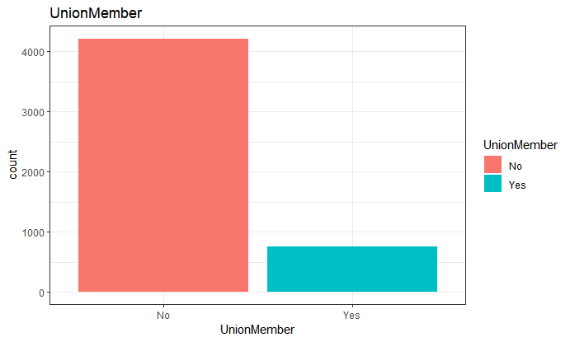
GG PLOT
Males and females are equally distributed in the data
Most of the customers are not in any trade union

Slide 8
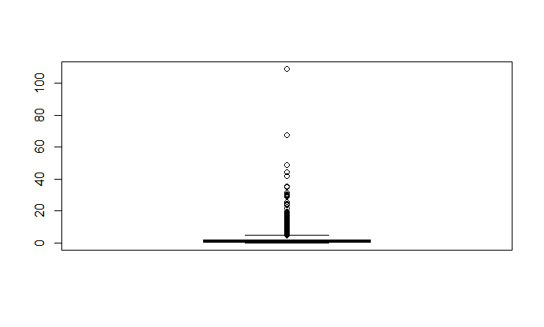
Outliers
The data contains outliers We used the outcome variables to remove the outliers.

Slide 9
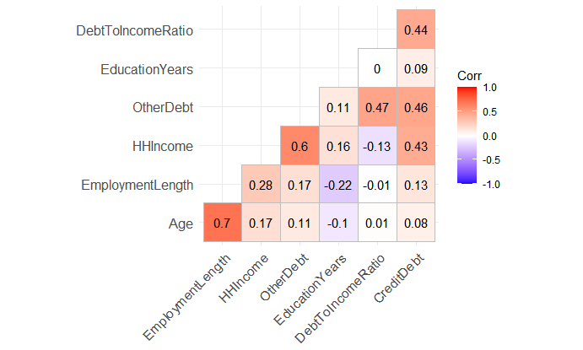
Correlation
Positive moderate correlation between credit debt and other debt.
Positive moderate correlation between debt-to-income ratio and credit debt.

Slide 10
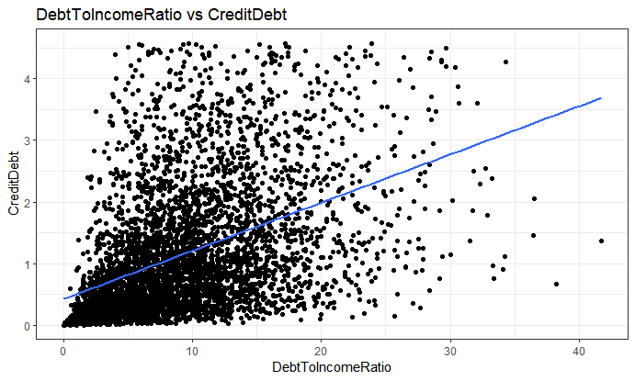
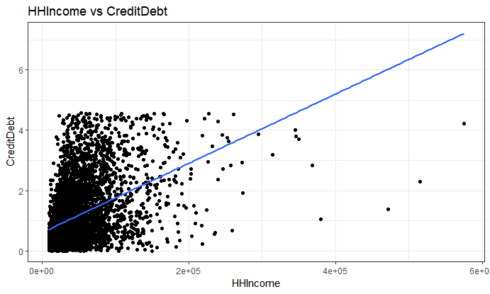
Relationship Visualizations
As DebtToIncomeRatio and HHIncome increase, CreditCard debt also increases.

Slide 11
Building the Regression Model
In the evolution of our regression model, we strategically introduced two additional independent variables—OtherDebt and DebtToIncomeRatio. This augmentation resulted in a statistically significant improvement, with an R-squared of 0.4604. This indicates that 46.04% of the observed variability in the target variable can be explained by our refined model.
Upon a deeper dive into Model 2, we find that only three independent variables out of the introduced set (HHIncome, OtherDebt, DebtToIncomeRatio) exhibit statistical significance at the 0.05 level. This refinement, although slight, contributed to a further enhancement of the R-squared to 0.4607, now explaining 46.07% of the variability observed in the target variable. The inclusion of these variables has proven instrumental in bolstering the model's predictive power, shedding light on the nuanced relationships within our dataset.
Unveiling Influential Factors

Slide 12
Optimizing Model Precision
Taking our model refinement a step further, we implemented a log transformation on the independent variable. This transformation not only allowed us to handle influential values effectively but also contributed to an enhanced R-squared, now standing at 0.4615. This subtle yet impactful improvement signifies that 46.15% of the variability observed in the target variable is elucidated by our log-transformed model.
Remarkably, even with the log transformation, the number of significant variables holds steady at three, mirroring our previous model. This consistent significance emphasizes the robustness of our approach and reinforces the reliability of the identified influential factors within the dataset.
Log Transformation Insight

Slide 13
Model Assumptions
As DebtToIncomeRatio and HHIncome increase, CreditCard debt also increases.

Slide 14

Model Assumption Assessment: Diagnosing Residuals
Residuals vs Fitted:
Normal Q-Q Plot:
Purpose: Check the linearity assumption.
Observation: A distinct pattern in the plot indicates that the linear relationship assumption
Purpose: Examine normal distribution of residuals.
Observation: Deviation from the straight dashed line suggests that the residuals are not normally distributed.
Scale-Location :
Residuals vs Leverage:
Purpose: Assess homogeneity of variance (homoscedasticity).
Observation: Lack of a horizontal line with equally spread points indicates that the assumption of homoscedasticity was not met.
Purpose: Identify influential cases.
Observation: Notable values (4483, 686, 1874) signify potential issues, implying that the assumption of no influential cases may not hold.

Slide 15
Drawing Conclusions: Unraveling Insights
Statistical Significance
The p-value, standing below 0.05, leads us to reject the null hypothesis. This strongly indicates a significant relationship between Household Income (HHINCOME) and credit card debt.
Effect Size:
At the 0.05 significance level, our model boasts an R-squared of 0.188. This signifies that 18.8% of the variability observed in the target variable (credit card debt) can be explained by our regression model.
Interpretation of Coefficient:
For every one-unit increase in Household Income, the model predicts a corresponding increase in credit card debt by 1.147e-05 units. This quantitative insight further underscores the influence of income on credit dynamics.

Slide 16

THANK YOU
For Your Attention
nardossolomon.com

